Slide 1
Practical Machine Learning
Deep Learning

Slide 2
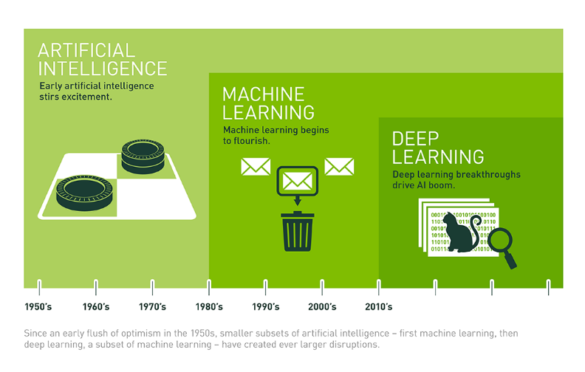
What is Deep Learning

Slide 3
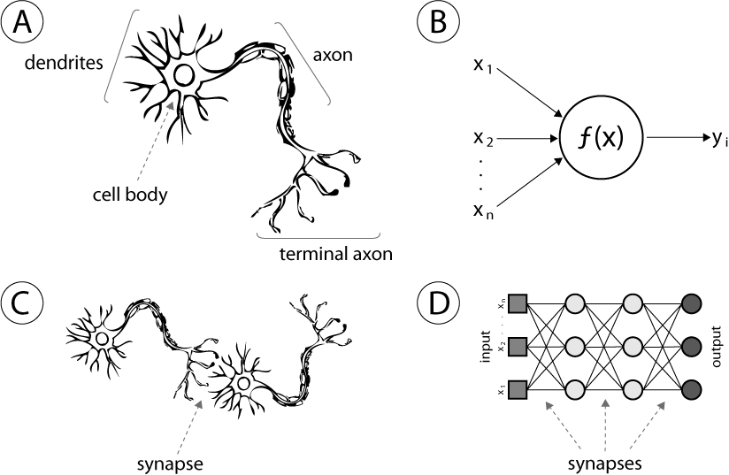
What is Neural Networks

Slide 4
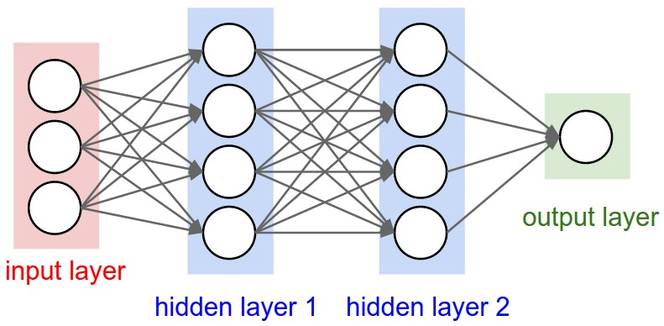
Neural Networks Representation

Slide 5
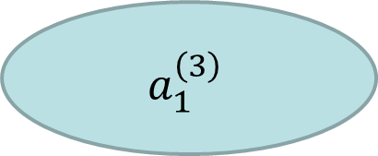
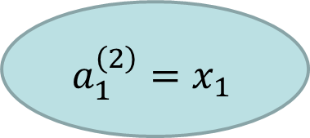
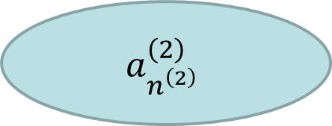
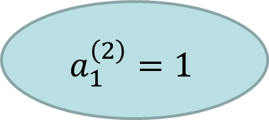
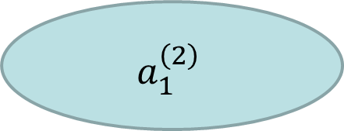
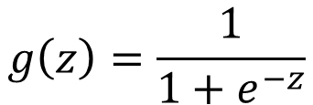
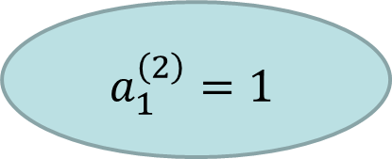

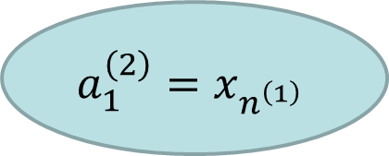

Forward propagation
$$a_{1}^{\left(2\right)}=1$$
$$a_{1}^{\left(2\right)}=1$$
$$a_{1}^{\left(2\right)}=x_{1}$$
$$a_{1}^{\left(2\right)}$$
$$a_{1}^{\left(3\right)}$$
…
…
$$a_{1}^{\left(2\right)}=x_{n^{\left(1\right)}}$$
$$a_{n^{\left(2\right)}}^{\left(2\right)}$$
$$g\left(z\right)=\frac{1}{1+e^{−z}}$$
$$z_{i}^{\left(j\right)}=w_{i}^{\left(j−1\right)}a^{\left(j−1\right)}$$
$$a_{i}^{\left(j\right)}=g\left(z_{i}^{\left(j\right)}\right)$$

Slide 6
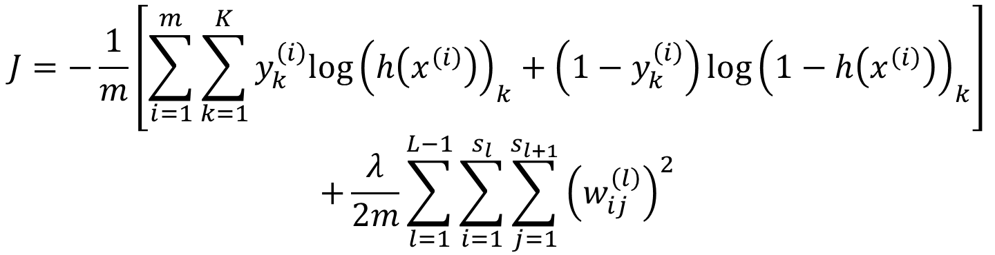
Cost function
$$J=−\frac{1}{m}\left[\sum_{i=1}^{m}{\sum_{k=1}^{K}{y_{k}^{\left(i\right)}log{\left(h\left(x^{\left(i\right)}\right)\right)}_{k}+\left(1−y_{k}^{\left(i\right)}\right)log{\left(1−h\left(x^{\left(i\right)}\right)\right)}_{k}}}\right]$$
$$+\frac{λ}{2m}\sum_{l=1}^{L−1}{\sum_{i=1}^{s_{l}}{\sum_{j=1}^{s_{l+1}}{{\left(w_{ij}^{\left(l\right)}\right)}^{2}}}}$$

Slide 7
Calculations of gradients
Finite differences method
Back propagation

Slide 8
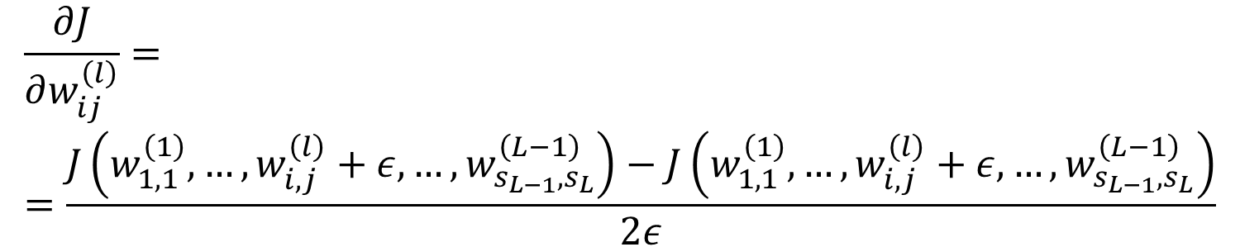
Gradients by finite differences
$$\frac{∂J}{∂w_{ij}^{\left(l\right)}}==\frac{J\left(w_{1,1}^{\left(1\right)}, …,w_{i,j}^{\left(l\right)}+ε,…,w_{s_{L−1},s_{L}}^{\left(L−1\right)}\right)−J\left(w_{1,1}^{\left(1\right)}, …,w_{i,j}^{\left(l\right)}+ε,…,w_{s_{L−1},s_{L}}^{\left(L−1\right)}\right)}{2ε}$$
Gradients by finite differences are often more expensive than gradients by backpropagation, but they are easy to implement. Use them only to check the accuracy of backpropagation

Slide 9

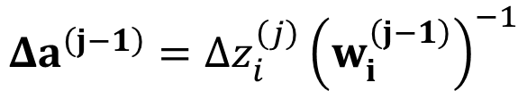

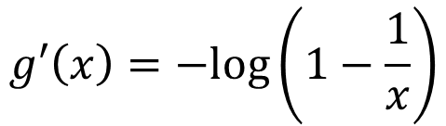
Gradients by backpropagation
$$Δa_{i}^{\left(L\right)}=a_{i}^{\left(L\right)}−y_{i}$$
Error with respect to the output
Enroll the network to get the gradient for each coefficient
$$g′\left(x\right)=−log\left(1−\frac{1}{x}\right)$$
$$Δz_{i}^{\left(j\right)}=g′\left(Δa_{i}^{\left(j\right)}\right)$$
$$Δa^{\left(j−1\right)}={Δz}_{i}^{\left(j\right)}{\left(w_{i}^{\left(j−1\right)}\right)}^{−1}$$

Slide 10
Random Initialization
Initial values of coefficients should not be equal (or zeros), as this introduces symmetry in the network. This symmetry can not be broken during optimization (backpropagation of finite differences). Therefore consider set coefficients to small but random values.

